Slide 1

Dota 2
Statistics
Presented By:-
Sujoy Kar (01577342) &
Hardik Sankhla (01617980)
CIS : 602 Special Topics
-Data Visualization

Slide 2

Abstract
1) The main goal of our project
is to provide visualization related
to the popular game Dota 2.
2) We aim to provide the statistics
of the game using a Choropleth Map
Visualization, 3D Radar Chart
Visualization and a stacked bar chart
using tooltips.

Slide 3
A Choropleth Visualization
Provide a visualization using the Live Datasets provided by Steam API.
Target Gamer’s game data and calculate the recent games that were recorded in different countries and show a visualization.
While hovering over a country should provide observer with the detail of users playing in that particular country with the number of users.

Slide 4
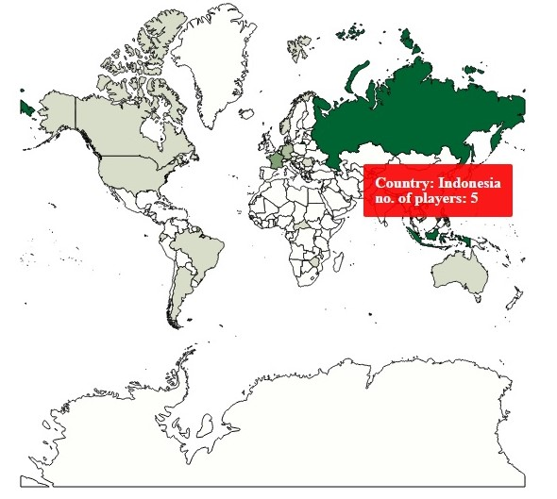
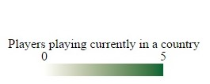
Choropleth visualization for the Recent Games played

Slide 5
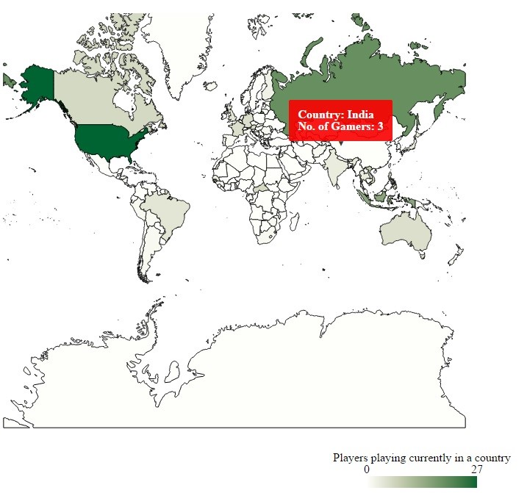
Choropleth Visualization for Games recorded for a Day at different intervals

Slide 6
Data set Limitations while creating the Choropleth
Users playing the game should set their game profile to Public in order for us to access their game & private details using the Steam API.
Incomplete user profile details resulted in providing an inaccurate population detail of users playing in each country.
Needed to use Asynchronous methods to access the database (e.g. Adding a delay)

Slide 7
3D Radar Chart Visualization
Our aim was to provide an in depth relative comparison of the countries in which the game is being played.
The comparison helps in giving a better view and a specific understanding as to where the game is even more popular.
Reference: http://www.visualcinnamon.com/2015/10/different-look-d3-radar-chart.html

Slide 8
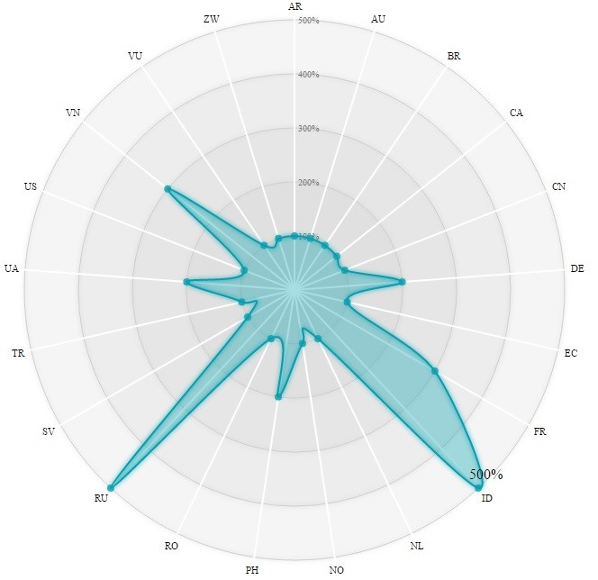
3D Radar Chart for the Recent Games played

Slide 9
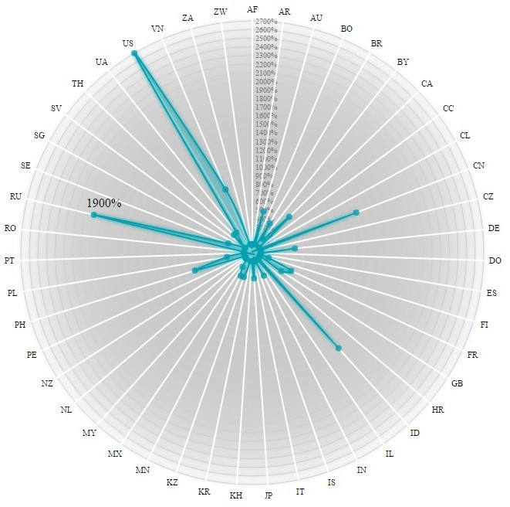
3D Radar Chart for Games recorded for a Day at different intervals

Slide 10
Why two different representations of Datasets?
Current scenario and past data representation provides a proper insight for the observer to understand the development of the game.
Was there an increase in the number of gamers in the country?
Where is the game more popular after comparing past & current data?

Slide 11
Stacked Bar Chart Visualization to find the Hero trend & popularity
Provide the latest trend of Hero’s being picked by Players.
Getting each Hero’s personal Win/Loss total with other important details like GPM (Gold per minute), XPM (Experience per minute), etc.
Top Most and Least most picked Heros by players.

Slide 12
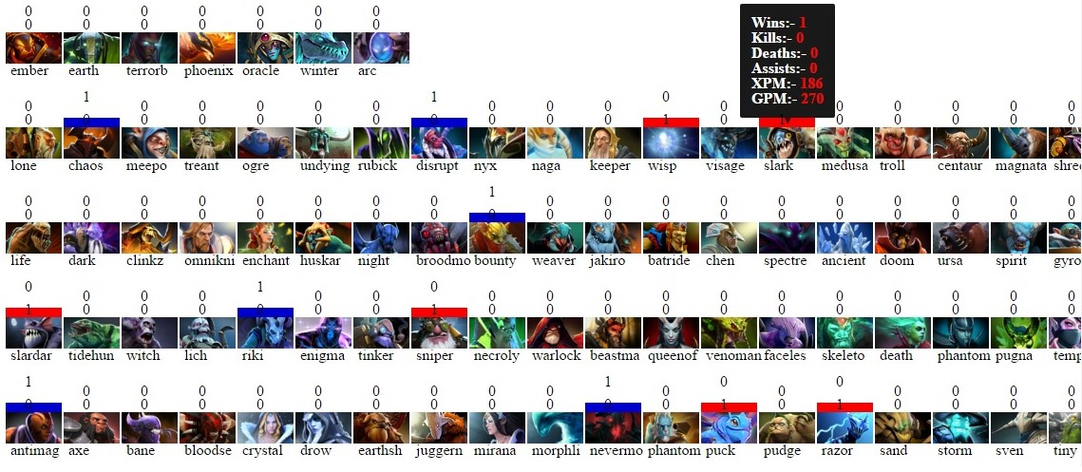
Hero Trend providing details for each Hero and their statistics

Slide 13
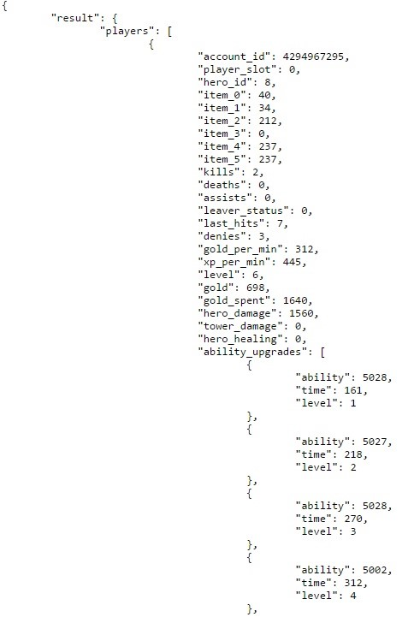
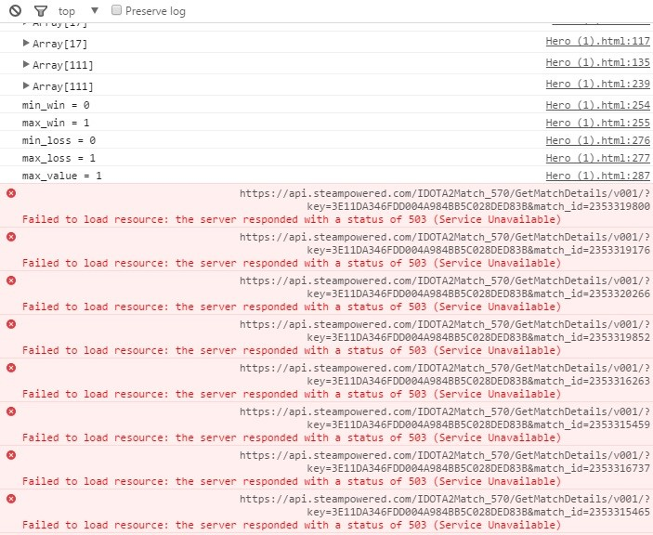
Limitations and difficulties faced during accessing live data from Steam API
Steam API Servers crashed
Data Set of the Match_id = 2353319800

Slide 14
Limitations and Difficulties (Continued)
Calling more number of requests to the Steam API server caused heavy load on the servers resulting in issues with the data retrieval process from the steam database.

Slide 15
What observer can derive or can infer from the visualizations?
Where is the game most played both currently and during a phase of time?
Was the game successful in gaining interests of players in a particular country to play it?
What is the current Trend in picking up Hero by players all over the globe?
Which Hero has the most Win or loss?
A Hero maybe amongst the most popular picks, but may have more number of losses compared to wins. Why?
Hero maybe picked more because its more Fun to play. Probable answer for the above question.
You can infer the probable causes for a hero’s loss or win based on hero’s stats like XPM & GPM.

Slide 16
More Implementations that could have been done?
Create Hero Icons and Hero Details in the tooltip itself while hovering the Bar Chart making the bar chart a bit compact.
Create a line chart or bar chart inside a tooltip when hovering over the stacked bar chart.

Slide 17
Thank You
Questions?

